Slide 1
Deterministic vs Probabilistic Models

Slide 2
Deterministic Model
A model that would hypothesize an exact relationship between variables.
Imagine that we believe you will score a little worse on your final than your midterm. A deterministic model could be
y = 0.95x

Slide 3
Error
However, we know this will not be true for every individual. Thus, we need to also include some leeway.
y = 0.95x + Random error
The above model is called the probabilistic model.

Slide 4
Probabilistic Model
This model includes a deterministic component and a random-error component.
We always assume the mean of the random error equals 0.
This is equivalent to assuming that the mean value of y, E(y), equals the deterministic component of the model.

Slide 5
General Form of Model
y = Deterministic component + ε
y = E(y) + ε
y = response variable
Deterministic component = E(y) = Mean (or expected value) of y
ε = unexplained or random error

Slide 6
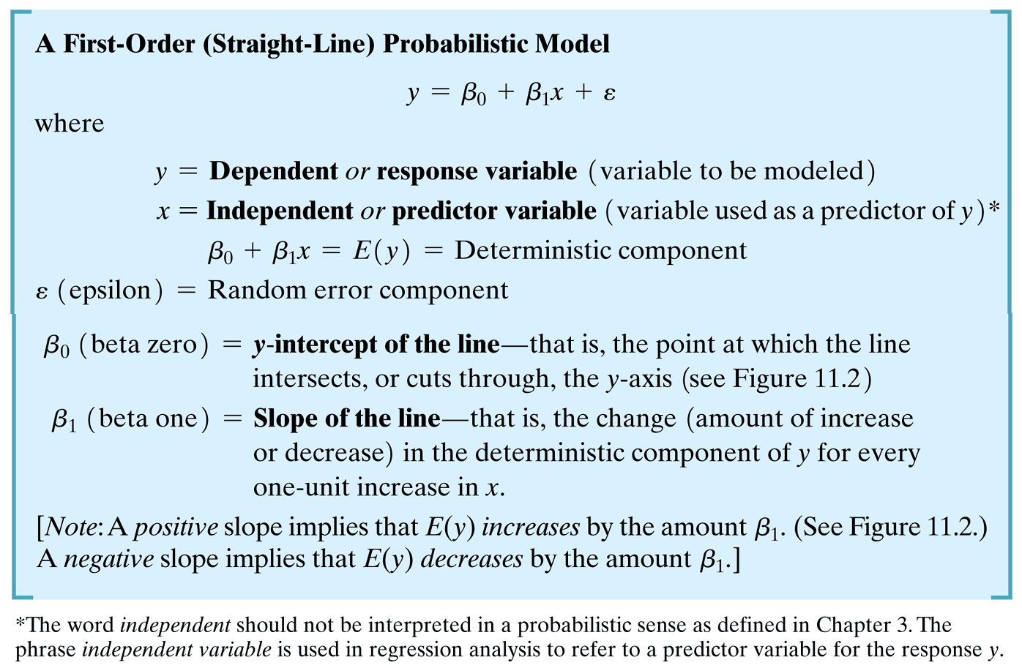

Slide 7
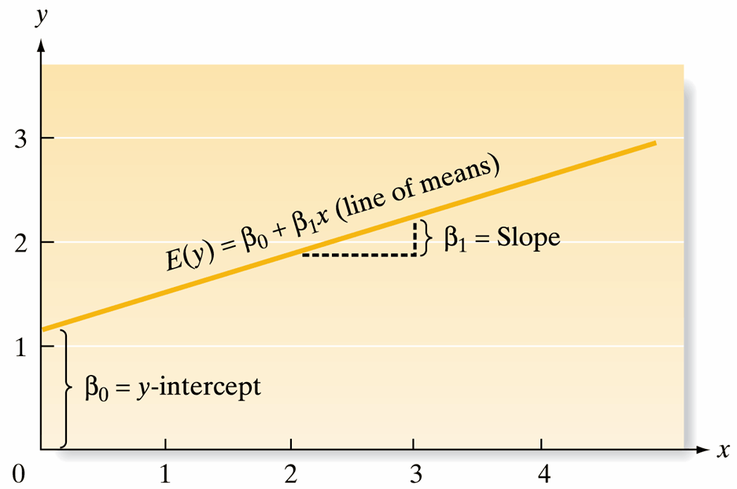
The First-Order Model

Slide 8
Estimating βs
The coefficients β₀ and β₁ are population parameters and are generally unknown.
The process of developing a model (i.e. estimating the unknown parameters) is a multi-step procedure.
See next slide.

Slide 9
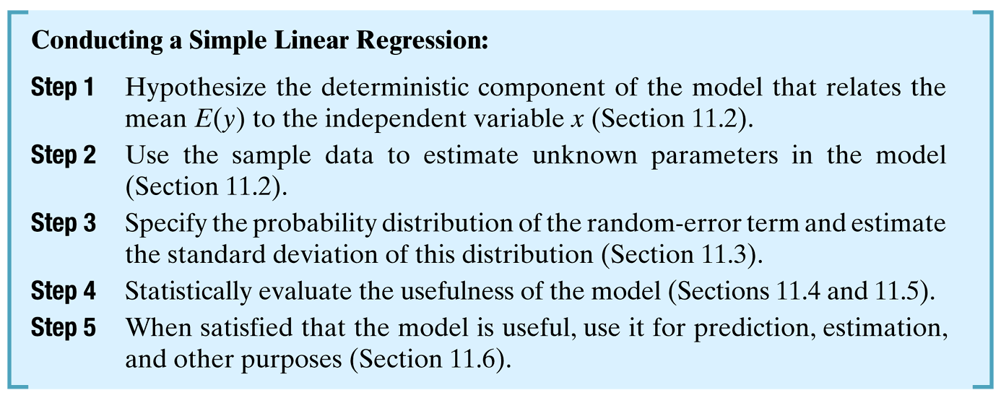
Procedure – textbook page 589

Slide 10
Some practice
Sec 11.1 page 589

Slide 11
Graphing in StatCrunch
Graph → Scatter plot
Choose the explanatory variable as the x column
Choose the response variable as the y column.
General Title: x-variable vs. y-variable
Axis labels: titles of columns will appear by default, if you want to edit them, you may.
Click Compute!

Slide 12
Data

Slide 13
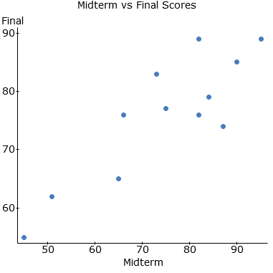

Slide 14
Correlation
The correlation measures the direction and strength of a linear relationship between two numerical variables.
The symbol for the sample correlation is r.
Also known as the Pearson’s correlation coefficient.

Slide 15
Correlation Formula
s_{x} and y_{x} are the sample standard deviations for the x and y columns of data, respectively.
Note: you are actually finding the z-scores for each ordered pair (x, y) and multiplying.

Slide 16
Grades Example: Correlation
StatCrunch: Stat → Summary Stats → Correlation
Click both variables you are using into the box o the right (remember to hold the control key to select more than one).
Click Compute!
Correlation between Midterm and Final is: 0.86230789

Slide 17
Correlation Properties
Correlation always satisfies -1 ≤ r ≤ 1.
+1 means perfect positive correlation
0 means no correlation or no linear relationship (could have curved relationship).
-1 means perfect negative correlation.
Response and explanatory variables are interchangeable
Unitless and not resistant to outliers.

Slide 18
Regression Analysis
A branch of statistical methodology concerned with relating a response y to a set of independent, predictor variables x₁,x₂, …, x_{k}
The goal is to build a prediction equation relating y to the independent variables that will enable us to predict y for given values of x₁,x₂, …, x_{k} and to do so with a small error of prediction.

Slide 19
Introduction
We want to model or describe how variables are related.
Is there a relationship between midterm and final exam score?
We will use the method of least squares to build the simple linear model.

Slide 20
The Straight Line Probabilistic Model
Consider sales price of a house.
We understand that the square footage of a house would be related to the sales price.
Can we say that if we use the square footage, we could exactly predict the sales price of a particular house?

Slide 21
Random Phenomena
Unfortunately, that is not possible. Sales price depends on many other variables (location, age, …)
Even if we included all independent variables we could think of in a model, there will be some variation in sales price strictly due to random phenomena (that cannot be explained).

Slide 22
Probabilistic Model
We introduced the probabilistic model below…
y = E(y) + ε
Where ε represents all unexplained variations in sales price caused by omitted variables or unexplainable random phenomena.

Slide 23
More Information about ε
The error term enables us to estimate the magnitude of the error of prediction when the model is used to predict some value of y.
It also plays a role in the calculation of confidence intervals and the construction of hypothesis tests.

Slide 24
Method of Least Squares
Using the book’s method, we will calculate estimates of the slope and y-intercept first for an example dealing with expenditure vs. sales revenue

Slide 25
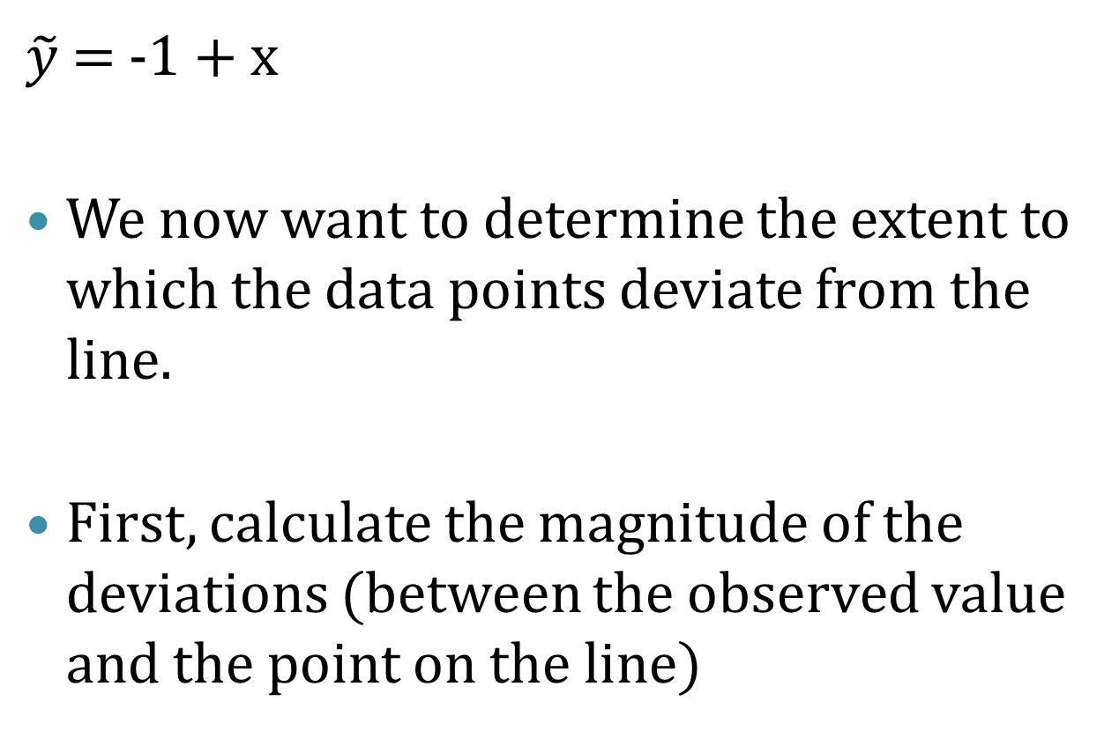
Visual Equation
$\tilde{y}$ = -1 + x
We now want to determine the extent to which the data points deviate from the line.
First, calculate the magnitude of the deviations (between the observed value and the point on the line)

Slide 26
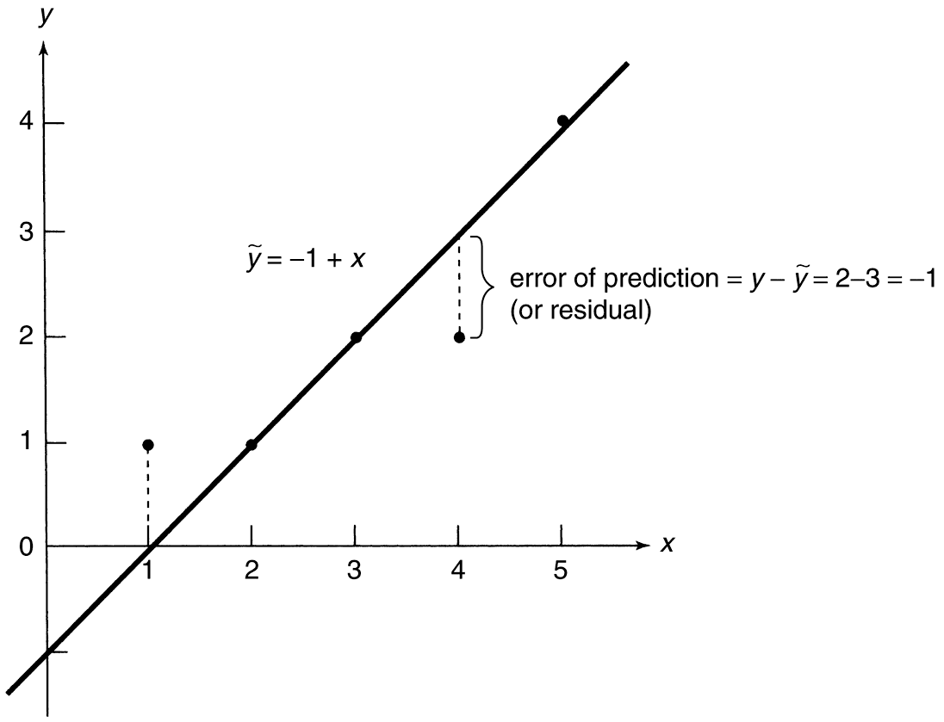
Visual Line through 3 Points

Slide 27
Definitions
Errors in Prediction (or deviations, or residuals) are the vertical distances between observed and predicted values of y.
Sum of the Errors (SE): add the residuals. Should always equal 0.
Sum of Squares of the Errors (SSE): handles the nature of the values (positive and negative).

Slide 28
Note
There are many lines where the sum of the errors (SE) is 0.
However, it can be shown that there is one and only one line for which the SSE is a minimum.
This line is called the least squares line or the regression line.

Slide 29
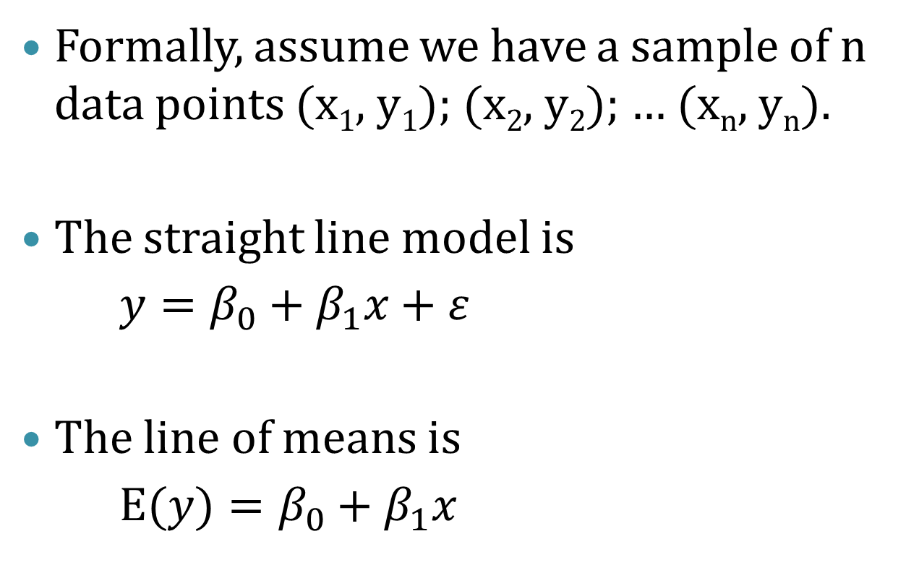
Calculating the Least Squares Line
Formally, assume we have a sample of n data points (x₁, y₁); (x₂, y₂); … (x_{n}, y_{n}).
The straight line model is
$y=β_{0}+β_{1}x+ε$
The line of means is
E($y)=β_{0}+β_{1}x$

Slide 30
Calculating the Least Squares Line
The fitted line (the one we attempt to calculate) is
For a given data point (x_{i}, y_{i}) the observed value of y is y_{i} and the predicted value of y is obtained by substituting x_{i} into the fitted line equation.

Slide 31
Calculating the Least Squares Line
The deviation of the ith value of y from its predicted value, called the ith residual is
Then, the sum of squares of the deviations of the y-values about their predicted values (SSE) for all n data points is

Slide 32
Residuals
Error = observed y – predicted y
Also called the residual
The least-squares regression line of y on x is the line that makes the sum of the squares of the vertical distances of the data points from the line as small as possible.

Slide 33
Coefficient Estimates
The values of that make the SSE a minimum are called the least squares estimates of the population parameters
To estimate these quantities, use the following equations…

Slide 34
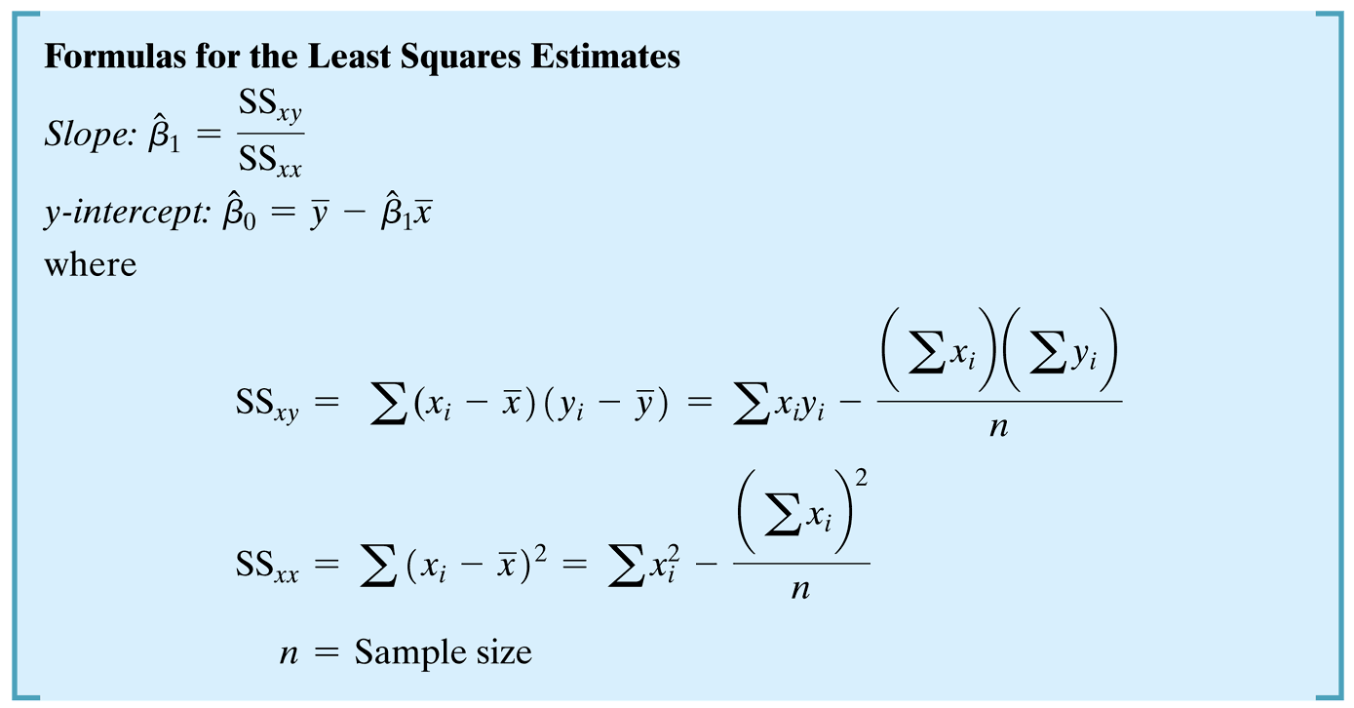
Formulas

Slide 35
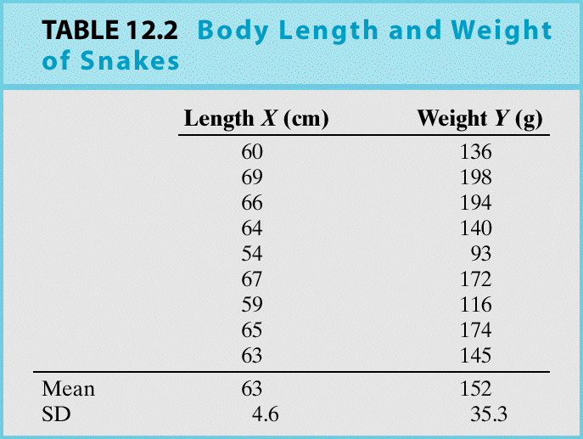
Example: Can we predict the weight of a snake simply by measuring its length?
Y = snake weight (g) X = snake length (cm)

Slide 36
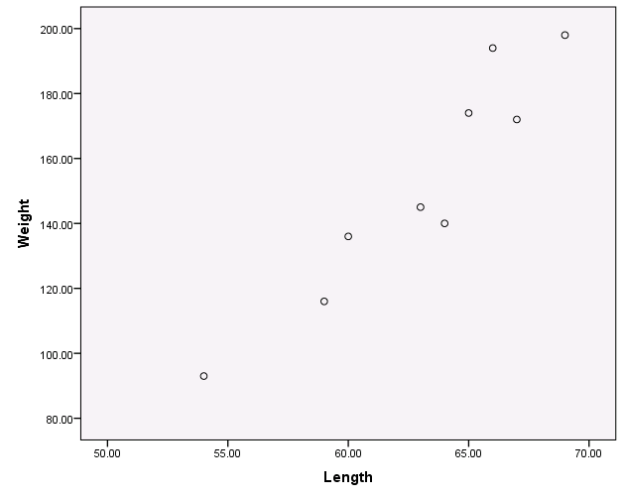
The snake data scatter plot shows a clear linear relation:

Slide 38
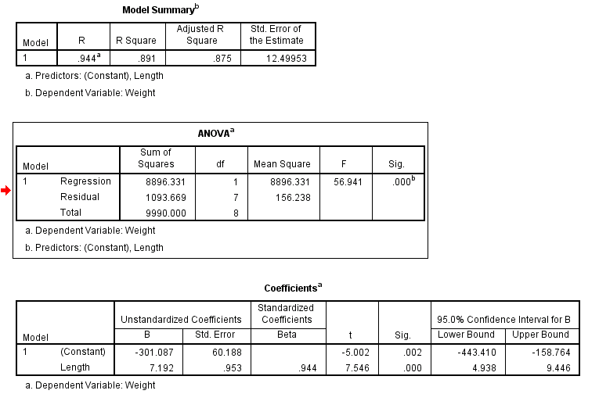
SPSS Linear Regression Output

Slide 39
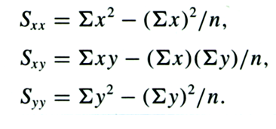
Recall the formulae for the intercept and slope can be found by

Slide 41
S_{xx}= 35893-(567²/9) = 172
S_{xy} = 87421-((567*1368)/9)=1237
S_{yy}= 217926-(1368²/9)=9990
b₁=1237/172=7.1918
b₀=152-(7.1918*63) = -301.0834

Slide 42
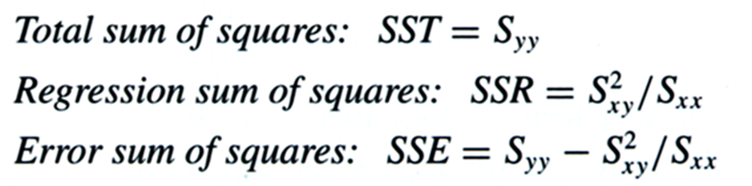
What about the ANOVA table?
SST = 9990
SSR = 1237²/172=8896.331
SSE = 9990-8896.331=1093.6686

Slide 43
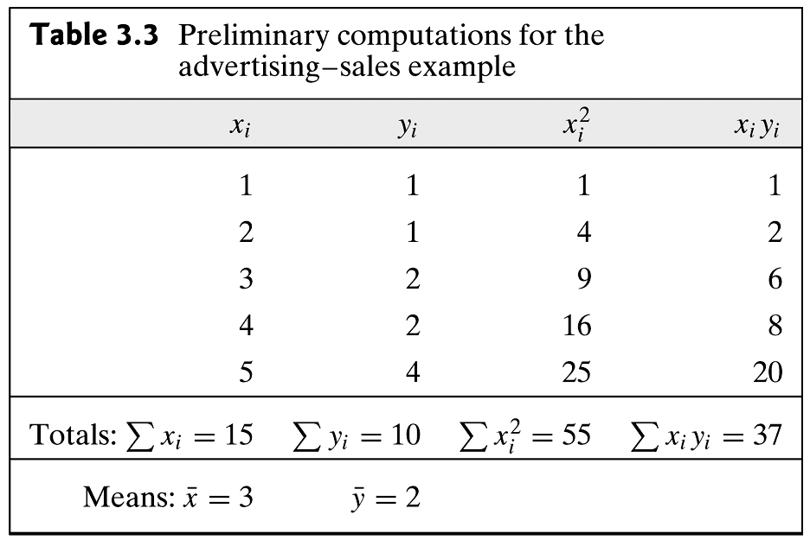
Example #2

Slide 44
Calculations
SS_{xy} = 37 – 5(3)(2) = 37 – 30 = 7
SS_{xx} = 55 – 5(3)² = 55 – 45 = 10
Slope = 7/10 = 0.7
y-int. = 2 – (0.7)(3) = 2 – 2.1 = – 0.1

Slide 45
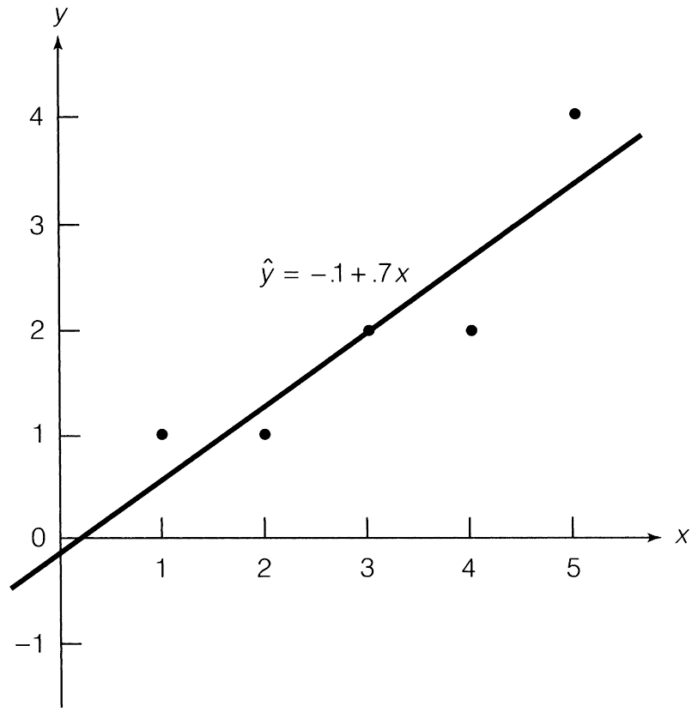
Graph

Slide 46
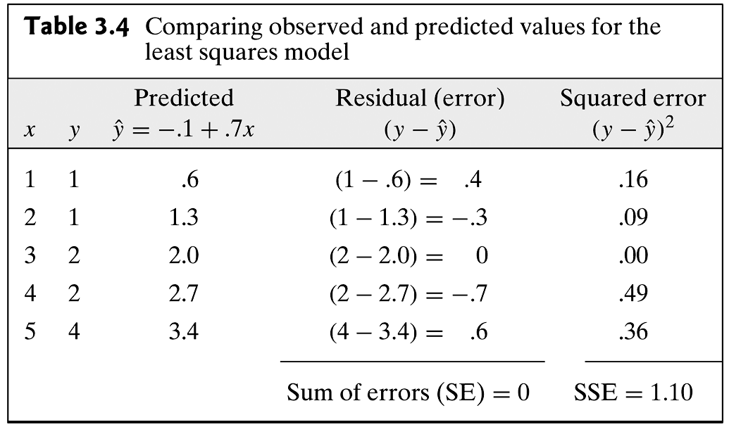
Work

Slide 47
StatCrunch Output
Let’s produce it.
Stat → Regression → Simple Linear
Correctly choose the response, y and explanatory, x variables.
The fitted line plot is already selected by default.
Click Compute!

Slide 48
Interpretation: Slope
The slope of 0.7 means that the mean sales revenue y will increase 0.7 units for every 1-unit increase in advertising expenditure x.
Using correct units, mean monthly sales revenue increases $700 for every $100 increase in monthly advertising expenditure.

Slide 49
Interpretations: y-intercept
Generally, the value of y when x = 0
Only meaningful when the straight line pattern intersects zero.
Generally extrapolation.
Here our value is negative.

Slide 50
Facts about Regression
If we reverse the roles of the explanatory and response variables, we will get a different regression line
The slope, b₁ is related to the correlation coefficient, r
The least-squares line passes through the means of the x and y variables.
The proportion of the variation in the values of y that is explained by the regression line is r²

Slide 51
ANOVA table (Simple Linear Regression)
Source | Sum of squares SS | DF | Mean square MS | F | P-value
Regression Model |  | 1 | SSR/DFR | MSR/MSE | Tail area above F
Error (Residual) |  | n − 2 | SSE/DFE
Total |  | n − 1
SST = SSM+ SSE
DFT = DFM + DFE

Slide 52
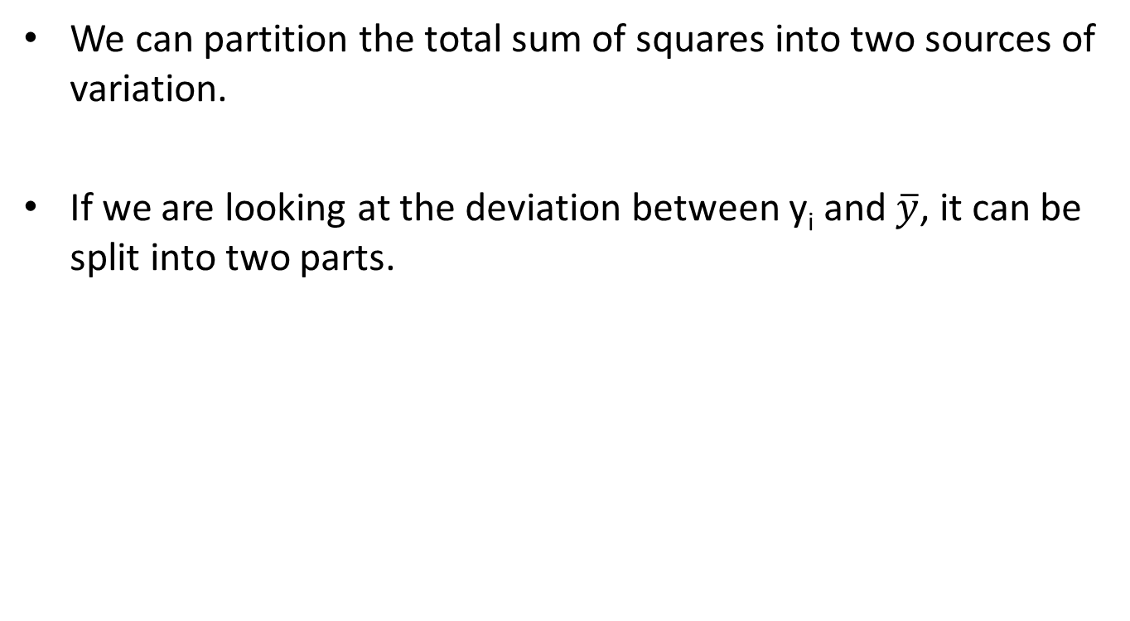
Information
We can partition the total sum of squares into two sources of variation.
If we are looking at the deviation between y_{i} and $\overline{y}$, it can be split into two parts.

Slide 53
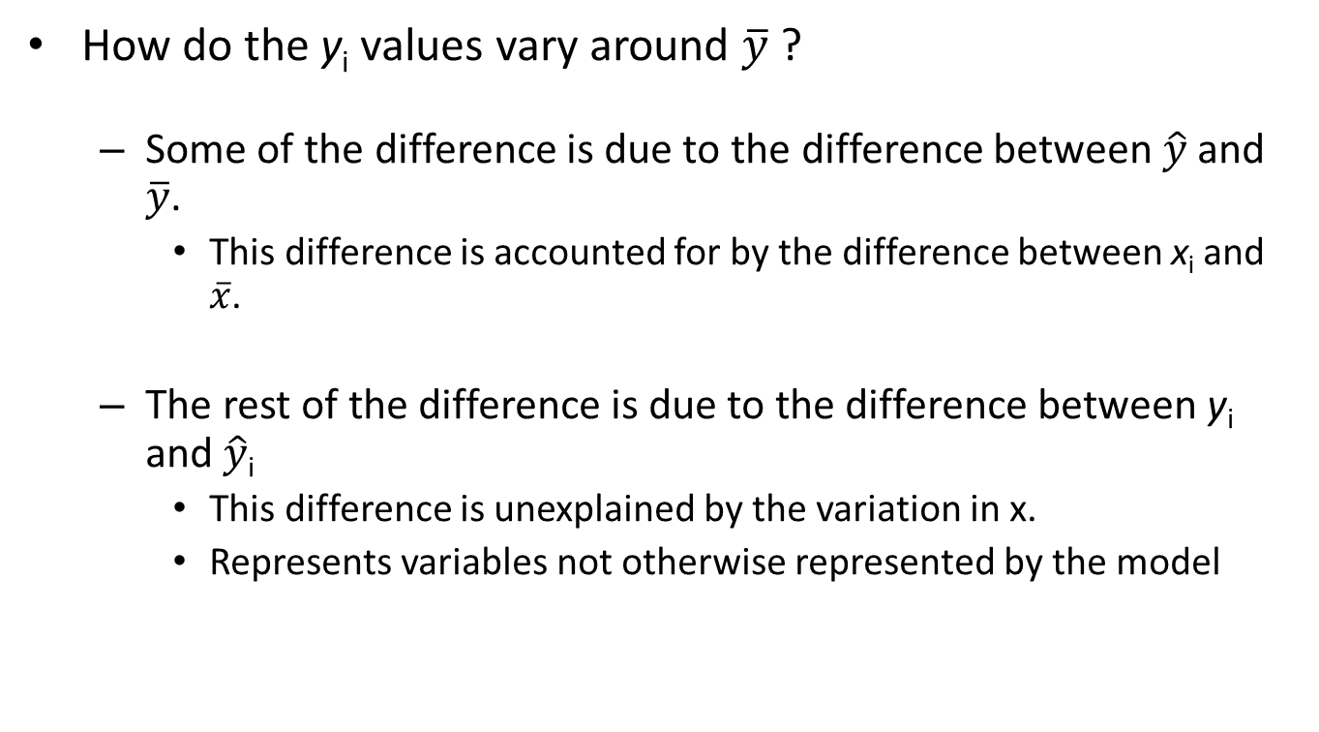
Question
How do the y_{i} values vary around $\overline{y}$ ?
Some of the difference is due to the difference between $\hat{y}$ and $\overline{y}$.
This difference is accounted for by the difference between x_{i} and $\overline{x}$.
The rest of the difference is due to the difference between y_{i} and $\hat{y}$_{i}
This difference is unexplained by the variation in x.
Represents variables not otherwise represented by the model

Slide 54
Understanding Variation
Looking at the past equation
as sums of squares…
We see
Variation in y = SSE + SSM

Slide 55
Variation of y
SSE measures the amount of variation in y that remains unexplained
SSM measures the amount of variation in y that is explained by the variation in the independent variable x.

Slide 56
Visualizing Errors in the Simple Model

Slide 57
Connection to R²
Therefore:
The coefficient of determination, r², square of the correlation coefficient, is the percentage of the variance in y (vertical scatter from the regression line) that can be explained by changes in x.

Slide 58
Coefficient of determination, r²
The coefficient of determination, r², square of the correlation coefficient, is the percentage of the variance in y (vertical scatter from the regression line) that can be explained by changes in x.
r ² ₌ variation in y caused by x (i.e., the regression line)
total variation in observed y values around the mean

Slide 59
Model Assumptions
The mean of the probability distribution of ε is 0.
The variance of the probability distribution of ε is constant for all settings of the independent variable x.
The probability distribution of ε is normal.
Errors associated with any two different observations are independent.

Slide 60
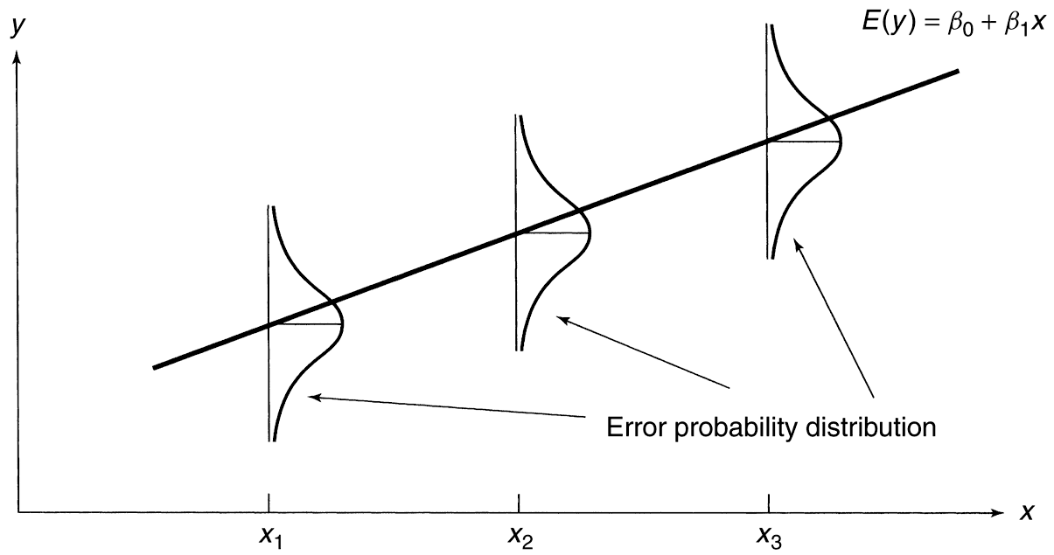
Image

